Slide 1

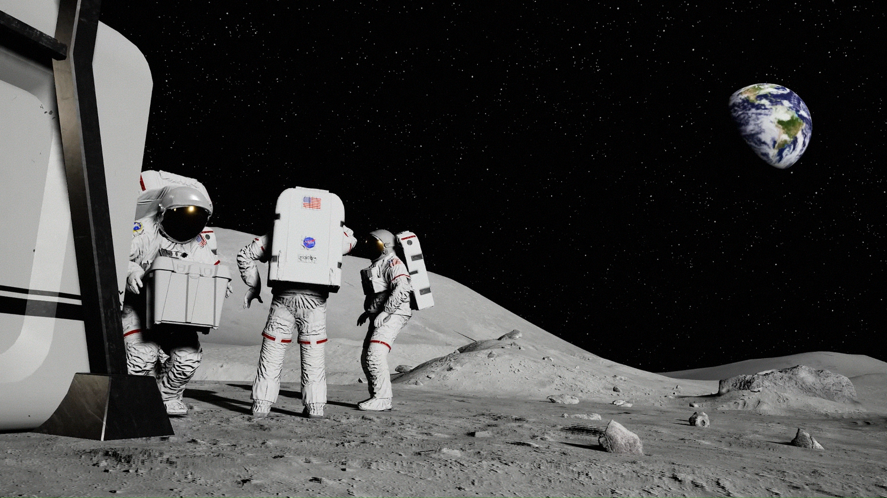
In-Space Cryogenic
Propellant Storage
Team 512
Anna Gilliard | Liam McConnell | Samantha Myers | Brandon Young
Notes:
insert new CAD pics
Fix morph on zoom slides 27-28
Make 33 pretty
Add other conclusions we took from papers to extra slides

Slide 2




Team Introductions
Anna Gilliard
Fluids Engineer
Liam McConnell
Cryogenics Engineer
Samantha Myers
Dynamics Engineer
Brandon Young
Materials Engineer
Samantha Myers

Slide 3



Sponsor and Advisor
Rachel McCauley
NASA Marshall Space Flight Center
Travis Belcher
NASA Marshall Space Flight Center
Wei Guo
FAMU-FSU College of Engineering
Samantha Myers

Slide 4

Project Objective
The objective of this project is to design a storage tank for cryogenic propellant that increases storage time, reduces fuel loss, and reduces heat transfer.
Samantha Myers
Summary
Current Design
Testing
Future Work
Lessons Learned

Slide 5






Key Goals
Samantha Myers
Summary
Current Design
Testing
Future Work
Lessons Learned

Slide 6
Key Goals
Maintain temperature
Samantha Myers
Summary
Current Design
Testing
Future Work
Lessons Learned

Slide 7
Key Goals
Maintain pressure
Maintain temperature
Samantha Myers
Summary
Current Design
Testing
Future Work
Lessons Learned

Slide 8
Key Goals
Maintain pressure
Maintain temperature
Reduce
heat transfer
Samantha Myers
Summary
Current Design
Testing
Future Work
Lessons Learned

Slide 9
Key Goals
Maintain pressure
Reduce
fuel loss
Maintain temperature
Reduce
heat transfer
Samantha Myers
Summary
Current Design
Testing
Future Work
Lessons Learned

Slide 10
Key Goals
Maintain pressure
Reduce
fuel loss
Maintain temperature
Reduce
heat transfer
Develop a prototype
Samantha Myers
Summary
Current Design
Testing
Future Work
Lessons Learned

Slide 11




Assumptions
Withstands Earth, space, and lift-off conditions
Test with liquid nitrogen
Lunar mission of two weeks
Samantha Myers
Summary
Current Design
Testing
Future Work
Lessons Learned

Slide 12
Critical Targets and Metrics
Samantha Myers
Summary
Current Design
Testing
Future Work
Lessons Learned

Slide 13
Critical Targets and Metrics
Maintain temperature of 77 K
Samantha Myers
Summary
Current Design
Testing
Future Work
Lessons Learned

Slide 14
Critical Targets and Metrics
Maintain temperature of 77 K
Maintain structural integrity for two weeks
Samantha Myers
Summary
Current Design
Testing
Future Work
Lessons Learned

Slide 15
Critical Targets and Metrics
Maintain temperature of 77 K
Maintain structural integrity for two weeks
Maintain pressure of ~30 psi
Samantha Myers
Summary
Current Design
Testing
Future Work
Lessons Learned

Slide 16
Concept Generation
All concepts are assuming double-shell, pill shaped tank.
Samantha Myers
Summary
Current Design
Testing
Future Work
Lessons Learned

Slide 17
Concept Generation
Multi-Layer Insulation
All concepts are assuming double-shell, pill shaped tank.
Samantha Myers
Summary
Current Design
Testing
Future Work
Lessons Learned

Slide 18
Concept Generation
Multi-Layer Insulation
Ceramic Supports
All concepts are assuming double-shell, pill shaped tank.
Samantha Myers
Summary
Current Design
Testing
Future Work
Lessons Learned

Slide 19
Concept Generation
Multi-Layer Insulation
Ceramic Supports
Film Reflecting Radiation
All concepts are assuming double-shell, pill shaped tank.
Samantha Myers
Summary
Current Design
Testing
Future Work
Lessons Learned

Slide 20
Original Design
Double-shell, pill shaped tank with MLI, vacuum between layers, reflective layer on the outside surface
Anna Gilliard
Summary
Current Design
Testing
Future Work
Lessons Learned
Notes:
At the end of last semester, this was the design concept that we selected. It is a double-shell, pill-shaped tank with MLI and a vacuum between the layers with a reflective layer on the outer surface. Most of the design components were chosen based on conclusions other researchers have made through testing. This is the design we continued to refine for our full-scale design that will be recommended to NASA, but we had to do a bit of simplifying to design our prototype.

Slide 21
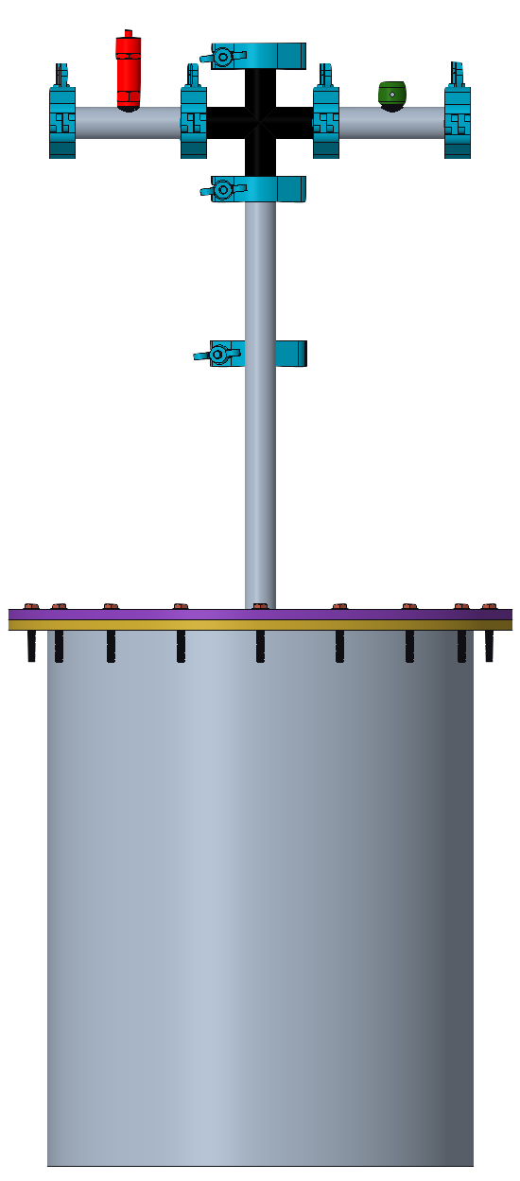
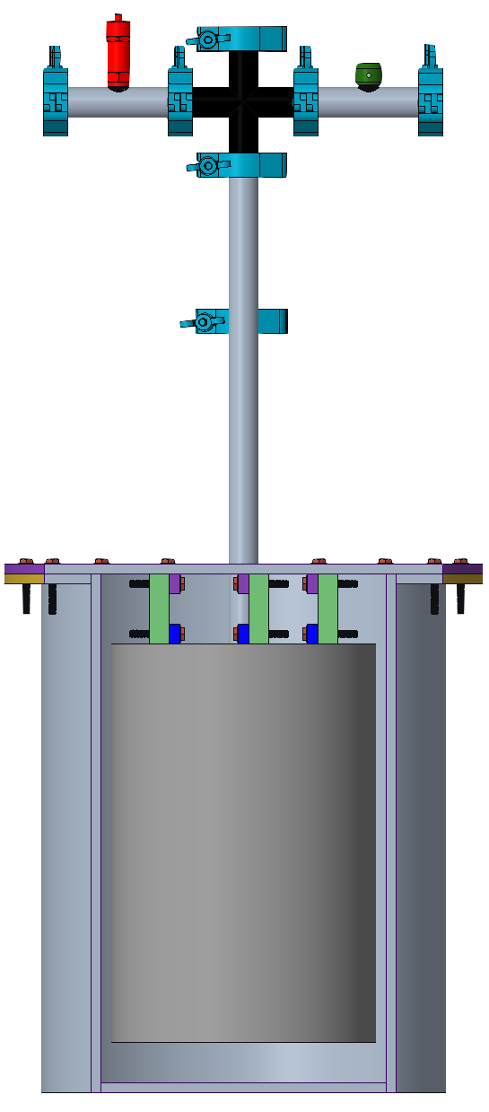
Current Prototype Design
Prototype Dimensions
Outer tank diameter: 25.72 cm
Outer tank height: 33.02 cm
Outer tank thickness: 0.95 cm
Inner tank diameter: 16.83 cm
Inner tank height: 25.40 cm
Inner tank thickness: 1.11 cm
Front View
Sectioned View
Anna Gilliard
Summary
Current Design
Testing
Future Work
Lessons Learned
Notes:
This is our current prototype design. It is a double shell tank with flat endcaps and a vacuum between the layers. We will be using foam insulation on the outer surface of the outer tank, but it will be sprayed on after construction, so it is not shown here. There will also be solid foam insulation around each of the exterior pipes. The machine shop had cylinders available for us to use, so that determined the tank diameters and heights. The diameters listed here are the outer diameters of the tanks. We made sure the thicknesses of the cylinders were appropriate based on a calculation resource provided to us by one of Dr. Guo’s graduate students.

Slide 22
Current Prototype Design
Top Flange
Bottom Flange
G10-CR
Inner Tank
Outer Tank
G10 Connectors
Sectioned View
Anna Gilliard
Summary
Current Design
Testing
Future Work
Lessons Learned
Notes:
Looking more into the details of the tank, here we have the top flange in purple and the bottom flange in yellow. The top flange will serve as the top of the outer tank, and the bottom flange will be welded to the top outer perimeter of the outer tank. There will be a liquid sealant put between the flanges and they will be bolted together. This should provide a seal good enough for the vacuum between the tanks to be effective.

Slide 23
Current Prototype Design
Top Flange
Bottom Flange
G10-CR
Inner Tank
Outer Tank
G10 Connectors
Sectioned View
Anna Gilliard
Summary
Current Design
Testing
Future Work
Lessons Learned

Slide 24
Current Prototype Design
Top Flange
Bottom Flange
G10-CR
Inner Tank
Outer Tank
G10 Connectors
Sectioned View
Anna Gilliard
Summary
Current Design
Testing
Future Work
Lessons Learned
Notes:
Next, we have three G10-CR plates to provide support between the inner and outer tanks, shown in the light and dark grey colors. G10-CR was chosen due to its low thermal conductivity. In blue, there are three metal plates welded to the top of the inner tank, as well as three metal plates welded to the inside of the top flange. The G10 will be bolted to these metal plates to secure them to the tank.

Slide 25
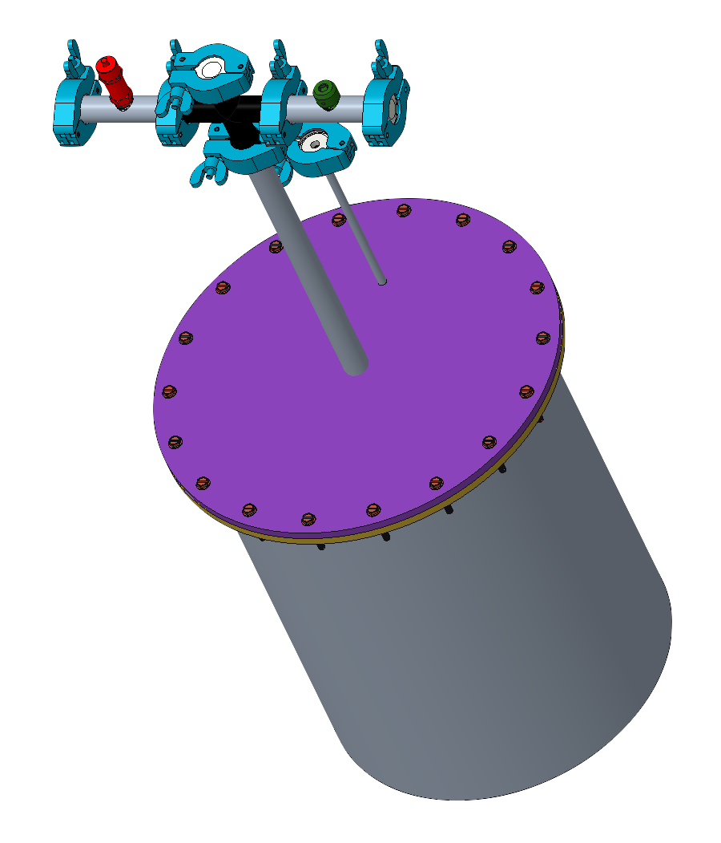
Current Prototype Design
Clamps
Cross Valve
Pressure Relief Valve
Vent
Stainless Steel Pipes
Bolts
Top Flange
Outer Tank
Vacuum Port
Angled Top View
Anna Gilliard
Summary
Current Design
Testing
Future Work
Lessons Learned
Notes:
This figure shows the angled top view of the prototype, so we can see the details of the top section more clearly.

Slide 26
Current Prototype Design
Clamps
Cross Valve
Pressure Relief Valve
Vent
Stainless Steel Pipes
Bolts
Top Flange
Outer Tank
Vacuum Port
Angled Top View
Anna Gilliard
Summary
Current Design
Testing
Future Work
Lessons Learned
Notes:
First, in light blue, we have 7 clamps. There is an O-ring for each clamp to ensure good seals. They are used to connect the cross-valve, which is here in black, to the stainless-steel pipes, in grey, as well as three endcaps, in white for each opening. The end shown here will be used for filling the tank.

Slide 27
Current Prototype Design
Clamps
Cross Valve
Pressure Relief Valve
Vent
Stainless Steel Pipes
Bolts
Top Flange
Outer Tank
Vacuum Port
Angled Top View
Anna Gilliard
Summary
Current Design
Testing
Future Work
Lessons Learned
Notes:
Next, in red, we have the pressure release valve, that will release the gas built up inside the tank when the internal pressure of the tank reaches 30 psi.

Slide 28
Current Prototype Design
Clamps
Cross Valve
Pressure Relief Valve
Vent
Stainless Steel Pipes
Bolts
Top Flange
Outer Tank
Vacuum Port
Angled Top View
Anna Gilliard
Summary
Current Design
Testing
Future Work
Lessons Learned
Notes:
In green, we have a vent that is necessary for releasing additional gas while the tank is being filled. Under that is the vacuum port, where a pump will be connected by the clamp to produce our vacuum.

Slide 29
Current Prototype Design
Clamps
Cross Valve
Pressure Relief Valve
Vent
Stainless Steel Pipes
Bolts
Top Flange
Outer Tank
Vacuum Port
Angled Top View
Anna Gilliard
Summary
Current Design
Testing
Future Work
Lessons Learned
Notes:
Finally, here is another look at the flanges and their connection with the bolts.

Slide 30
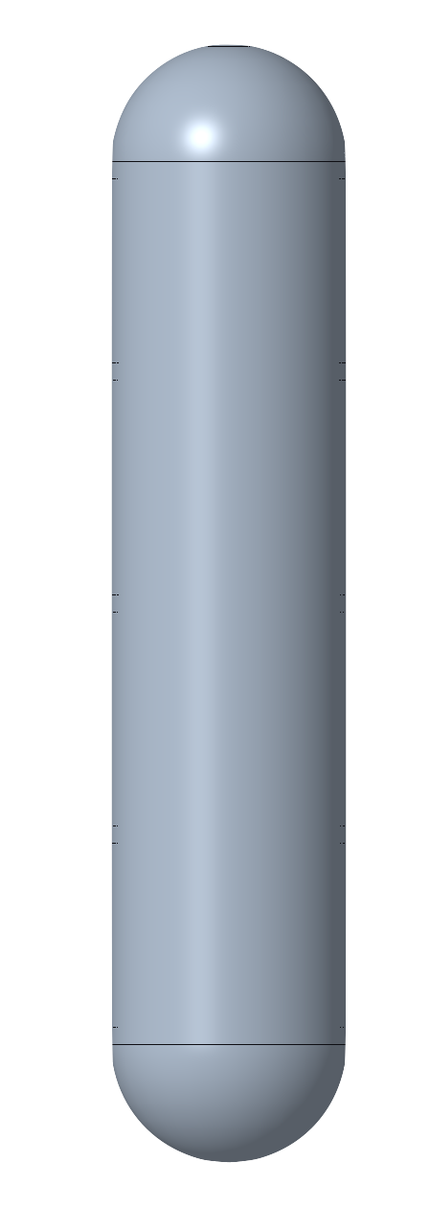
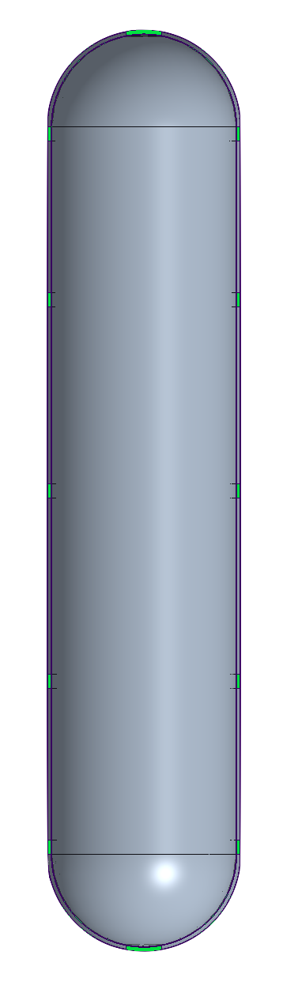
Recommended Full-Size Design
Full-Size Dimensions
Outer tank diameter: 8.37 m
Outer tank height: 39.75 m
Outer tank thickness: 0.03 m
Inner tank diameter: 8.00 m
Inner tank height: 39.38 m
Inner tank thickness: 0.03 m
Front View
Sectioned View
Brandon Young
Summary
Current Design
Testing
Future Work
Lessons Learned
Notes:
Dimensions based on SLS hydrogen tank

Slide 31
Recommended Full-Size Design
Outer Tank
Inner Tank
G10 Supports
MLI
Sectioned View
Brandon Young
Summary
Current Design
Testing
Future Work
Lessons Learned

Slide 32
Recommended Full-Size Design
Outer Tank
Inner Tank
G10 Supports
MLI
Sectioned View
Brandon Young
Summary
Current Design
Testing
Future Work
Lessons Learned

Slide 33
Recommended Full-Size Design
Outer Tank
Inner Tank
G10 Supports
MLI
Sectioned View
Brandon Young
Summary
Current Design
Testing
Future Work
Lessons Learned

Slide 34
Recommended Full-Size Design
Liquid Hydrogen or Oxygen
Spherical endcaps
Sealed vacuum
Aluminum 2219
Volume of ~530,668 gallons
MLI
G10-CR supports
Sectioned View
Brandon Young
Summary
Current Design
Testing
Future Work
Lessons Learned
Notes:
- explain why we can't use these for our prototype

Slide 35
Current Prototype Design
Liquid Nitrogen
Flat endcaps
Active vacuum
Stainless Steel 304
Volume of ~1.24 gallons
Foam insulation
G10-CR supports
Sectioned View
Brandon Young
Summary
Current Design
Testing
Future Work
Lessons Learned
Notes:
- explain why these choices are good alternatives

Slide 36
Recommended Full-Size Design
Liquid Nitrogen
Liquid Hydrogen or Oxygen
Flat endcaps
Spherical endcaps
Active vacuum
Sealed vacuum
Stainless Steel 304
Aluminum 2219
Volume of ~1.24 gallons
Volume of ~530,668 gallons
Foam insulation
MLI
G10-CR supports
G10-CR supports
Brandon Young
Summary
Current Design
Testing
Future Work
Lessons Learned
Notes:
- explain why we can't use these for our prototype

Slide 37
Recommended Full-Size Design
Liquid Nitrogen
Liquid Hydrogen or Oxygen
Flat endcaps
Spherical endcaps
Active vacuum
Sealed vacuum
Stainless Steel 304
Aluminum 2219
Volume of ~1.24 gallons
Volume of ~530,668 gallons
Foam insulation
MLI
G10-CR supports
G10-CR supports
Brandon Young
Summary
Current Design
Testing
Future Work
Lessons Learned
Notes:
- explain why we can't use these for our prototype

Slide 38
Recommended Full-Size Design
Liquid Nitrogen
Liquid Hydrogen or Oxygen
Flat endcaps
Spherical endcaps
Active vacuum
Sealed vacuum
Stainless Steel 304
Aluminum 2219
Volume of ~1.24 gallons
Volume of ~530,668 gallons
Foam insulation
MLI
G10-CR supports
G10-CR supports
Brandon Young
Summary
Current Design
Testing
Future Work
Lessons Learned
Notes:
- explain why we can't use these for our prototype

Slide 39
Recommended Full-Size Design
Liquid Nitrogen
Liquid Hydrogen or Oxygen
Flat endcaps
Spherical endcaps
Active vacuum
Sealed vacuum
Stainless Steel 304
Aluminum 2219
Volume of ~1.24 gallons
Volume of ~530,668 gallons
Foam insulation
MLI
G10-CR supports
G10-CR supports
Brandon Young
Summary
Current Design
Testing
Future Work
Lessons Learned
Notes:
- explain why we can't use these for our prototype

Slide 40
Recommended Full-Size Design
Liquid Nitrogen
Liquid Hydrogen or Oxygen
Flat endcaps
Spherical endcaps
Active vacuum
Sealed vacuum
Stainless Steel 304
Aluminum 2219
Volume of ~1.24 gallons
Volume of ~530,668 gallons
Foam insulation
MLI
G10-CR supports
G10-CR supports
Brandon Young
Summary
Current Design
Testing
Future Work
Lessons Learned
Notes:
- explain why we can't use these for our prototype

Slide 41
Recommended Full-Size Design
Liquid Nitrogen
Liquid Hydrogen or Oxygen
Flat endcaps
Spherical endcaps
Active vacuum
Sealed vacuum
Stainless Steel 304
Aluminum 2219
Volume of ~1.24 gallons
Volume of ~530,668 gallons
Foam insulation
MLI
G10-CR supports
G10-CR supports
Brandon Young
Summary
Current Design
Testing
Future Work
Lessons Learned
Notes:
- explain why we can't use these for our prototype

Slide 42
Recommended Full-Size Design
Liquid Nitrogen
Liquid Hydrogen or Oxygen
Flat endcaps
Spherical endcaps
Active vacuum
Sealed vacuum
Stainless Steel 304
Aluminum 2219
Volume of ~1.24 gallons
Volume of ~530,668 gallons
Foam insulation
MLI
G10-CR supports
G10-CR supports
Brandon Young
Summary
Current Design
Testing
Future Work
Lessons Learned
Notes:
- explain why we can't use these for our prototype

Slide 43
Recommended Full-Size Design
Liquid Nitrogen
Liquid Hydrogen or Oxygen
Flat endcaps
Spherical endcaps
Active vacuum
Sealed vacuum
Stainless Steel 304
Aluminum 2219
Volume of ~1.24 gallons
Volume of ~530,668 gallons
Foam insulation
MLI
G10-CR supports
G10-CR supports
Brandon Young
Summary
Current Design
Testing
Future Work
Lessons Learned
Notes:
- explain why we can't use these for our prototype

Slide 44
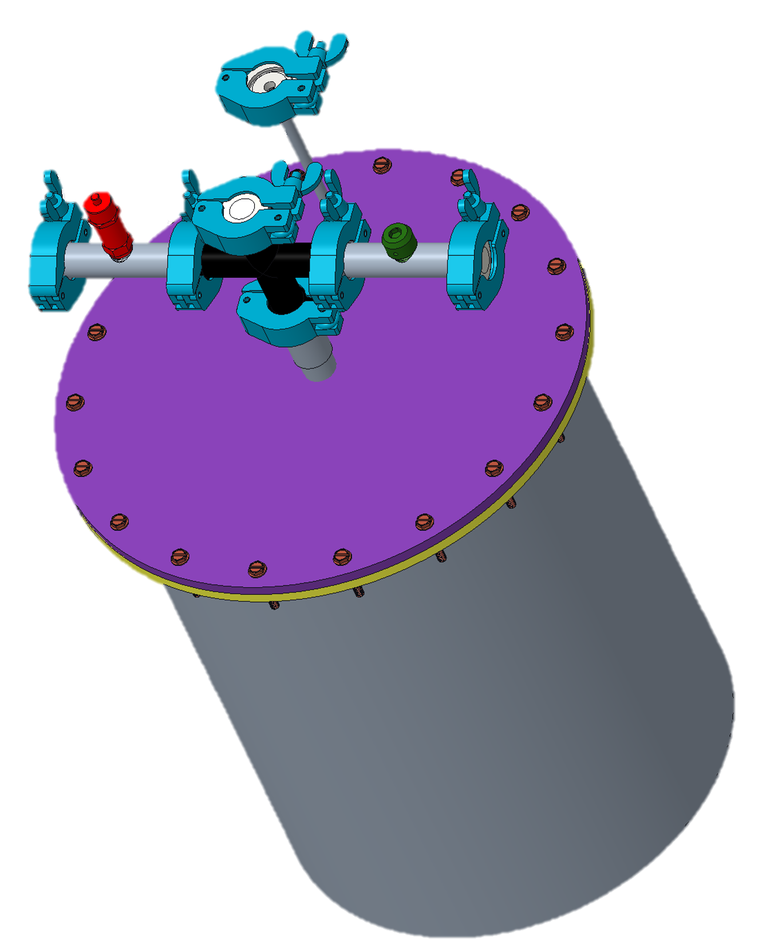
Before Testing
Pressure Relief Valve
Active Vacuum
Preset to release at 30 psi
Prove with pressurized air that it releases at correct pressure
Find error
Thermal camera to prove vacuum is effective with pictures
Liam McConnell
Summary
Current Design
Testing
Future Work
Lessons Learned
Notes:
- explain why these choices are good alternatives

Slide 45
Before Testing
pics/ how we found relief valve error
Brandon Young
Summary
Current Design
Testing
Future Work
Lessons Learned
Notes:
- explain why these choices are good alternatives

Slide 46
Before Testing
Thermal pics of tank with vacuum on and off
Brandon Young
Summary
Current Design
Testing
Future Work
Lessons Learned
Notes:
- explain why these choices are good alternatives

Slide 47
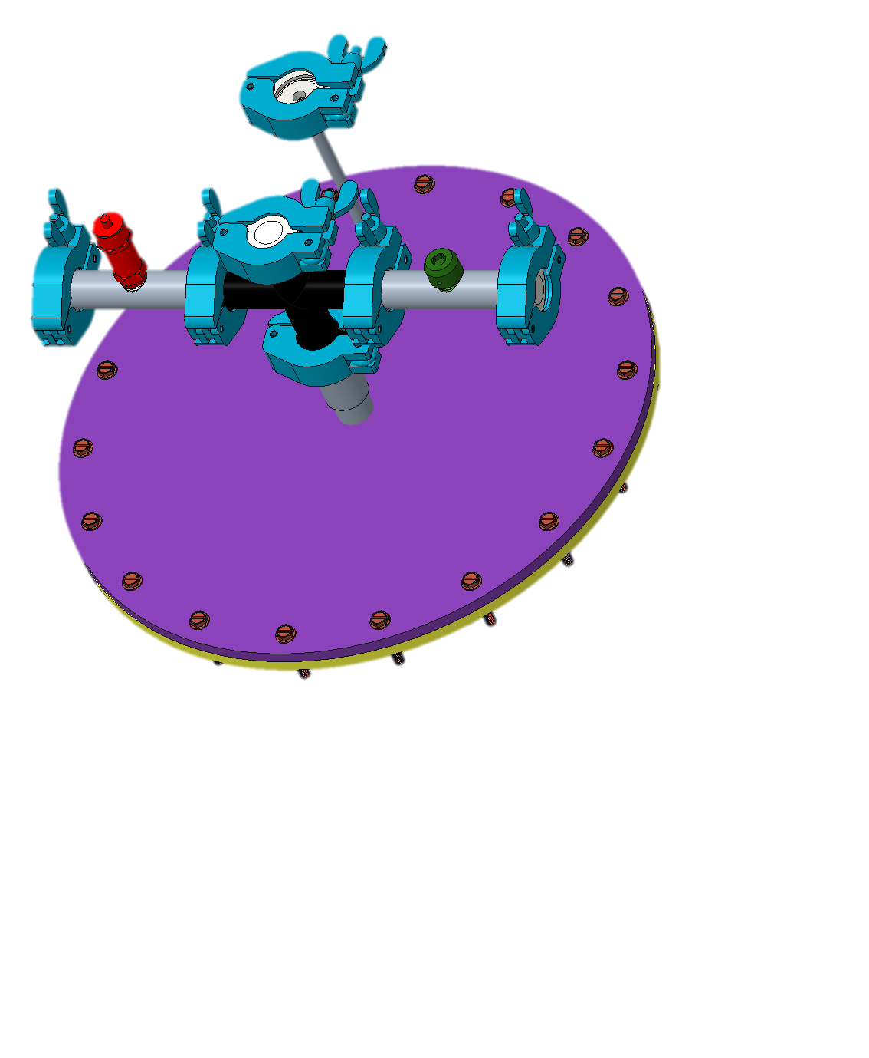
Testing Procedure
1. Open all end caps
2. Fill tank with line through port
3. Close fill port and end caps
4. Record mass every 8 hours
Liam McConnell
Summary
Current Design
Testing
Future Work
Lessons Learned
Notes:
- Last transition?

Slide 48
Testing Procedure
Recording Mass Flow Rate
  Weight of tank vs. time
Recording Mass of Fluid
  Scale
Liam McConnell
Summary
Current Design
Testing
Future Work
Lessons Learned

Slide 49
Testing Procedure
Maybe insert pics if we have any
Brandon Young
Summary
Current Design
Testing
Future Work
Lessons Learned

Slide 50
Testing Results
Weights and times
Liam McConnell
Summary
Current Design
Testing
Future Work
Lessons Learned

Slide 51
Design Validation
Obtain time required for all fluid to boil off.
Compare to calculated results.
Find experimental error.
Apply error to full-scale tank calculations.
Time for full-scale tank validates design choices.
Liam McConnell
Summary
Current Design
Testing
Future Work
Lessons Learned

Slide 52
Design Comparison
something about big tank calculations/expected time + error
Liam McConnell
Summary
Current Design
Testing
Future Work
Lessons Learned

Slide 53
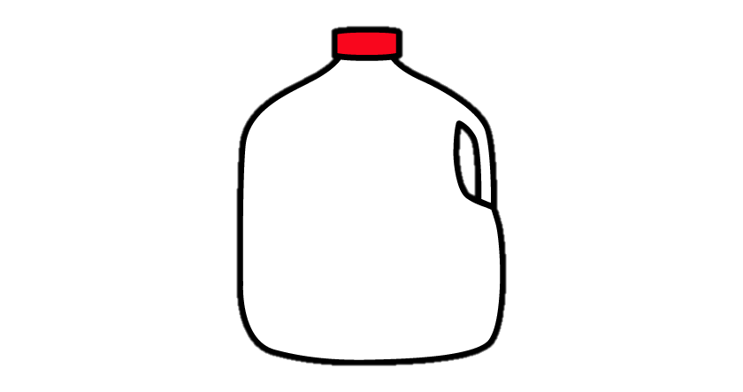


Challenges
Designing two
different tanks
Insulation change
Prototype tank size
Creo Parametric
G-10 geometry
Liam McConnell
Summary
Current Design
Testing
Future Work
Lessons Learned

Slide 54




Lessons Learned
Begin each step of design process early
Build stronger relationship with advisors
Communicate clearly and often
Discuss design with machine shop before finalizing or ordering
Liam McConnell
Summary
Current Design
Testing
Future Work
Lessons Learned

Slide 55
Future Work
Test Prototype
Mar. 24
Outline Possible Future Research
Apr. 1
Engineering Design Day
April 7
Relate Results to Full Scale Tank
Mar. 28
Final Report
April 12
Liam McConnell
Summary
Current Design
Testing
Future Work
Lessons Learned

Slide 56




In-Space Cryogenic
Propellant Storage
Team 512
Anna Gilliard | Liam McConnell | Samantha Myers | Brandon Young
Notes:
End on this slide for questions
​
Mention that the website is linked on our LinkedIn?

Slide 57
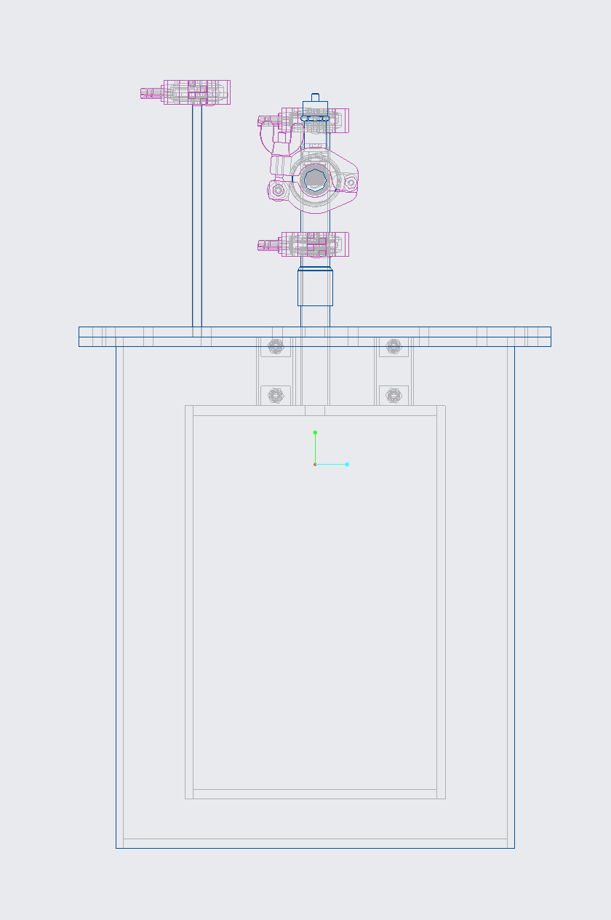
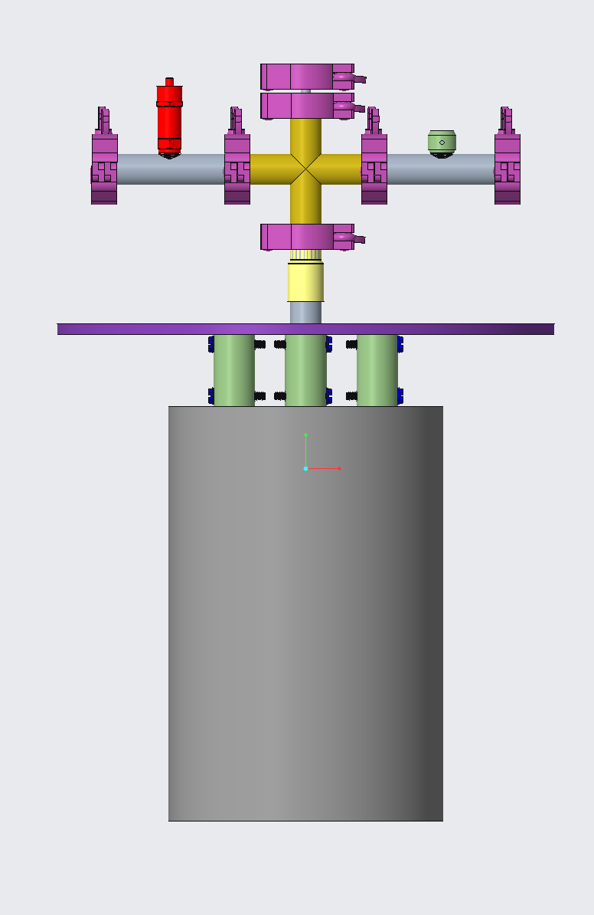

Slide 58
Insert new pics

Slide 59
Customer Needs
How long will the container be in space?
What type of fuel will be stored?
What conditions are we designing for?
What scale should be used?
Either liquid hydrogen or oxygen will be used.
The container must operate under all possible conditions.
It should be scalable to contain the required amount of fluid.
Select a hypothetical mission.
Anna Gilliard
Notes:
Next, we obtained our customer needs by asking our sponsor questions and interpreting their answers.
When asked how long we should design for the container be in space, NASA left our project relatively open ended, so we decided to design for a hypothetical mission to determine the duration.
The type of fuel that will be used in practice is either liquid hydrogen or liquid oxygen. These are the most common fuel types used in an RL10 engine. The RL10 engine is one of the commonly used for spacecraft at NASA.
We are designing for all possible conditions that the container could be under. In our case, this includes conditions on Earth, during the launch of the rocket, and in space. We must also account for the tank being filled and emptied. With the fluids being at such low temperatures, the material will expand and contract to some degree, so we need to ensure that the material we choose will not be subject to failure.
Finally, we need our prototype to scale to hold the required amount of propellant.

Slide 60
Customer Needs
Team Question | Provided Answer | Interpreted Need
Are we expected to fabricate the storage container? | Yes, prototype a scaled model. | The prototype has the ability to scale to a larger size.
What improvements can be made to current products? | Extend the amount of time the fuel can be stored. | The container has the ability to increase time maintained at cryogenic temperature and pressure.
Are we expected to perform experiments and present data to validate our design? | Yes, prototyping and testing are the main goal NASA has for this project. | The system has the ability to be validated for scientific calculations and design choices.
How long will the container be in space? | This factor is up to the group. | The system has the capability to be used on a hypothetical mission of a determined length.
Does NASA have a previous model that the group can improve? | NASA wants to see original ideas. It would be best to start from scratch. | The system has the capability to store cryogenic propellant with different materials and systems than previous models.
What type of fuel will be stored? | Liquid hydrogen or liquid oxygen. | Cryogenic container has the ability to hold liquid hydrogen or liquid oxygen and maintain them at the appropriate temperature and pressure.
What would be considered a successful project? | Improve how the container handles outside heat sources. | The container has the ability to decrease the rate of heat transfer more significantly in comparison to current state-of-the-art.
Are we designing for Earth, Mars, or the moon? | This factor is up to the group. | The cryogenic tank has the ability to store the propellant properly for the mission that the team decides to design for.
Does our design have to mount onto the ship in a certain way? | The storage container should work with existing state-of-the-art support structures. | Container has the ability to connect with other parts of the ship for structure.

Slide 61
Functional Decomposition
In-Space Cryogenic Propellant Storage Container
Samantha Myers
Notes:
From our background research, assumptions, and customer needs, we broke down the project into major and minor functions.

Slide 62
Functional Decomposition
In-Space Cryogenic Propellant Storage Container
Communicates to User
Stores
Insulates
Connects
Samantha Myers
Notes:
The main functions of our in-space cryogenic propellant storage container are to store the cryogen, insulate it from heat transfer, communicate to the user, and to be able to physically connect.

Slide 63
Functional Decomposition
Stores
Hold Cryogenic Fluid
Prevent Fuel Loss
Maintains Pressure
Samantha Myers
Notes:
The first main function is to store the fuel. To successfully store the cryogen, the container must prevent fuel loss, maintain a desired pressure, and contain the fluid.

Slide 64
Functional Decomposition
In-Space Cryogenic Propellant Storage Container
Communicates to User
Stores
Insulates
Connects
Samantha Myers
Notes:
The second major function to break down is insulation.

Slide 65
Functional Decomposition
Insulates
Decrease Heat Absorption
Increase Heat Loss
Samantha Myers
Notes:
In order to successfully insulate the propellant, the storage must increase heat loss from the system and decrease heat absorption into the system.

Slide 66
Functional Decomposition
In-Space Cryogenic Propellant Storage Container
Communicates to User
Stores
Insulates
Connects
Samantha Myers
Notes:
The third major function to break down is communicating to the user.

Slide 67
Functional Decomposition
Communicates to User
Displays on Container
Sends Information
Samantha Myers
Notes:
To successfully communicate to the user, the container must send information and display the information on the container.

Slide 68
Functional Decomposition
In-Space Cryogenic Propellant Storage Container
Insulates
Communicates to User
Connects
Stores
Samantha Myers
Notes:
The last major function of the storage container is to physically connect.

Slide 69
Functional Decomposition
Connects
Attaches to Interior of Spacecraft
Attaches Inner and Outer Shell
Samantha Myers
Notes:
To successfully connect, the storage must be attachable to the spacecraft, meaning some type of hole or way to attach struts or other connectors. It must also connect the inner and outer shells of the double-shell tank, ideally with minimal conduction.

Slide 70
Functional Decomposition
In-Space Cryogenic Storage Container
Stores
Communicates with User
Connects
Insulates
Holds cryogenic fluid without failure
Maintains pressure
Prevents fuel loss
Increases pressure
Decreases pressure
Minimize heat transfer
Reduce heat absorption through radiation
Reduce heat transfer through conduction
Sends information
Displays information
Attaches to interior of spacecraft
Attaches inner and outer shell
Connects metal
Connects tubes

Slide 71



Functions and Targets
Stores
Insulates
Connects
Samantha Myers

Slide 72




Targets and Metrics
Withstand 6 Gs of force
Maintain structural integrity for two weeks
Maintain pressure of 80 – 90 psi
Less than 1% mass boil off per day
Brandon Young

Slide 73


Targets and Metrics
Reflect all but 10 kJ of energy per square meter per day
Brandon Young
Notes:
Deleted: Inner shell receives less than 10 kJ of energy per day

Slide 74

Targets and Metrics
Information display synced to instruments to an accuracy of 1 second
Minimum 300 nit display, and 14-point font size
Gauges or dials are clear and easy to read
If the shells become brittle, the user will be alerted with a 80 decibel alarm
If the container leaks, the user will be alerted within 5 seconds with a 80 decibel alarm
Brandon Young
Notes:
If the shells become brittle, the user will be alerted with a 80 decibel alarm
If the container leaks, the user will be alerted within 5 seconds with a 80 decibel alarm

Slide 75

Targets and Metrics
Tank is fixed on inner walls of spaceship
Inner struts withstand 6 Gs of force
Useable for up to 5 missions
Brandon Young

Slide 76
Targets and Metrics
Function | Target
Holds cryogenic fluid without failure | Withstand 3 Gs of force on takeoff Maintain structural integrity for two weeks
Maintains pressure | Keep pressure between 80 and 90 psi for entire mission
Prevents fuel loss | Less than 1% per day mass boil off for the duration of the mission
Increases heat dissipated | Dispel all but 10 kJ of energy per unit volume per day
Decreases heat transfer | Inner tank will be subject to less than 10 kJ of energy per day
Communicate to user | Information display synchronized to instruments to the accuracy of a second
Displays on container | Digital presentation: at least 300 nit displays, 14-point font size or larger Analog Presentation: Gauges or dials clear and easy to read
Attaches to space craft interior | Attaching brackets can withstand 3 Gs of force upon takeoff Tank is fixed on inner walls of spaceship
Attaches inner and outer shell | Inner Struts can withstand 3 Gs of force on takeoff Useable for up to five missions If the storage container leaks, alerts user within 5 seconds with 80 decibels If metal becomes too brittle alert user with 80 decibels

Slide 77
Concept Generation
Morphological Chart
Geometry | Number of Layers | Thickness | Insulation
Cylinder | One | Thick | Coolant
Sphere | Two | Thin | Vacuum
Pill | Three |  | Foam
 |  |  | Powder
 |  |  | Fiber
 |  |  | Multi-layer

Slide 78

Concept Generation
Brainstorming
Liam McConnell
Notes:
Brainstorming – coming up with random ideas
Morphological chart – using a chart to combine basic ideas into more complex ideas
Biomimicry – Looking at nature for inspiration on insulation and shape

Slide 79
Concept Generation
Brainstorming
 | A | B | C
A | A | AB | AC
B | AB | B | BC
C | AC | BC | C
Morphological Chart
Liam McConnell
Notes:
Brainstorming – coming up with random ideas
Morphological chart – using a chart to combine basic ideas into more complex ideas
Biomimicry – Looking at nature for inspiration on insulation and shape

Slide 80

Concept Generation
Brainstorming
Morphological Chart
Biomimicry
Liam McConnell
Notes:
Brainstorming – coming up with random ideas
Morphological chart – using a chart to combine basic ideas into more complex ideas
Biomimicry – Looking at nature for inspiration on insulation and shape

Slide 81

Concept Generation
Double-Shell with Glass Bead Insulation
Triple-Shell with Vacuum
Double-Shell with Foam Insulation
Double-Shell Tank with Vacuum
Pill Shape with Powder Insulation
Anna Gilliard

Slide 82
Concept Selection
House of Quality
Pugh Chart
Analytical Hierarchy Process
Name

Slide 83
House of Quality
Time
Safety
Surface Area
Volume
Durability
Ease of Use
Cost
Liam McConnell
Notes:
Compares customer needs to characteristics

Slide 84
House of Quality
Time
Safety
Volume
Liam McConnell

Slide 85
Pugh Charts
MLI
Foam Insulation
Spherical Shape
Double-Shell Vacuum
Powder Insulation
Glass Bead Insulation
Film Insulation
Liam McConnell
Notes:
Compares concepts to engineering characteristics

Slide 86
Pugh Charts
MLI
Powder Insulation
Foam Insulation
Liam McConnell

Slide 87
Analytical Hierarchy Process
Time
Safety
Surface Area
Volume
Durability
Ease of Use
Cost
Liam McConnell
Notes:
MLI, Ceramic supports, reflective film
Compares engineering characteristics vs themselves

Slide 88
Analytical Hierarchy Process
Time
Safety
Volume
Liam McConnell
Notes:
MLI, Ceramic supports, reflective film

Slide 89
Analytical Hierarchy Process
Time
Safety
Volume
Design Rank | Design | Normalized Score
1 | Multi-Layer Insulation | 0.444
2 | Foam Insulation | 0.283
3 | Powder Insulation | 0.274
Liam McConnell

Slide 90
Concept Selection
Binary Comparison Chart
 | 1 | 2 | 3 | 4 | 5 | 6 | 7 | 8 | Total
1 | - | 1 | 1 | 1 | 1 | 1 | 1 | 1 | 7
2 | 0 | - | 1 | 0 | 0 | 0 | 0 | 0 | 1
3 | 0 | 0 | - | 0 | 0 | 1 | 1 | 0 | 2
4 | 0 | 1 | 1 | - | 0 | 0 | 0 | 0 | 2
5 | 0 | 1 | 1 | 1 | - | 1 | 1 | 1 | 6
6 | 0 | 1 | 0 | 1 | 0 | - | 1 | 1 | 4
7 | 0 | 1 | 0 | 1 | 0 | 0 | - | 1 | 3
8 | 0 | 1 | 1 | 1 | 0 | 0 | 0 | - | 3

Slide 91
Concept Selection
1 – Increase Storage Time | a – Volume
2 – Validate Design Choices | b – Surface Area
3 – Use of Hypothetical Mission | c – Time
4 – Store Cryogenic Propellant | d – Safety
5 – Maintain Temperature | e – Durability
6 – Maintain Pressure | f – Ease of Use
7 – Reduce Heat Transfer | g - Cost
8 – Connect to Existing Systems

Slide 92
Concept Selection
A – MLI in a Vacuum, Pill Shape | E – Powder Insulation – Pill Shape
B – Foam Insulation – Pill shape | F – Spherical Shape
C – Film Insulation – Pill Shape | G – Glass Bead Insulation – Pill Shape
D – Double Shell Vacuum – Pill Shape

Slide 93
Concept Selection

Slide 94
Concept Selection

Slide 95
Concept Selection

Slide 96
Concept Selection

Slide 97
Concept Selection

Slide 98
Concept Selection
Concept | Alternative Value | Rank
MLI - Pill Shape | 0.444 | 1
Foam Insulation - Pill Shape | 0.283 | 2
Powder Insulation Supports | 0.274 | 3

Slide 99
Heat Leak Calculations
Without Insulation
 | Prototype | Full-scale
Q_{rad} [W] | 3.06 | 11200
Q_{cond} [W] | 100.2 | 212000
Q_{total} [W] | 103.3 | 225000
Mass flow rate [kg/hr] | 1.86 | 1750
Time [hr] | 2.35 | 63.67
Time [day] | 0.098 | 2.65
Liam McConnell

Slide 100
Heat Leak Calculations
Foam and Vacuum Insulation
 | Prototype | Full-scale
Q_{rad} [W] | 3.07 | 11200
Q_{cond} [W] | 43.31 | 159000
Q_{total} [W] | 46.38 | 170000
Mass flow rate [kg/hr] | 0.83 | 1328
Time [hr] | 5.24 | 84.1
Time [day] | 0.22 | 3.5
Liam McConnell

Slide 101
Heat Leak Calculations
MLI and Vacuum Insulation
 | Prototype | Full-scale
Q_{rad} [W] | 1.25 | 6024
Q_{cond} [W] | 8.76 | 1063
Q_{total} [W] | 10.02 | 7090
Mass flow rate [kg/hr] | 0.18 | 55.35
Time [hr] | 24.24 | 2018
Time [day] | 1.01 | 84.1
Liam McConnell

Slide 102
Calculations
Radiation (Q_{rad}= 0.5*e*As*sigma*(T₁⁴ – T₂⁴))
e | 0.075
As (m^2) | 0.192186712
sigma (W/m^2K^4) | 5.67E-08
T1 (K) | 300
T2 (K) | 77
Q_dot_rad (W) | 3.295594838

Slide 103
Calculations
Conduction (Q_{cond}= k*Ac*(T1-T2)/L) *PER SUPPORT*
k (W/m*K) | 0.228
Ac (m^2) | 0.000475
T1 (K) | 300
T2 (K) | 77
L (m) | 0.0428625
Q_dot_cond (W) | 0.563450569
number of supports | 3
Q_dot_cond_tot (W) | 1.690351706

Slide 104
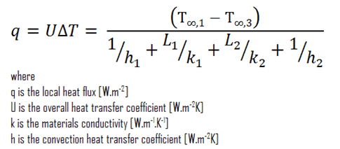
Calculations
Foam Heat Leak with Vacuum
T1 [K] | 300
T3 [K] | 77
k1 [W/mK] | 16
L1 | 0.125
k2 [W/mK] | 0.04
L2 | 1.375
q [W/m2] | 6.485798682
Surface Area [m2] | 0.192186712
Q [W] | 1.246484323

